Slide 1
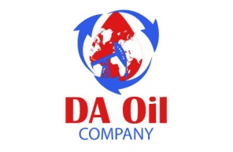
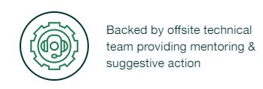
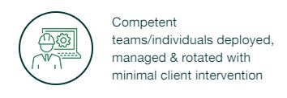
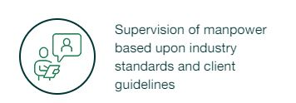
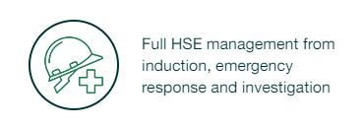
Supervisory support
Client Benefits

Slide 2
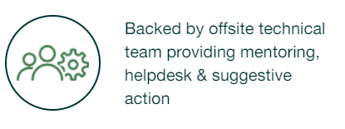
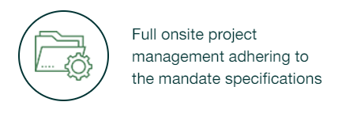
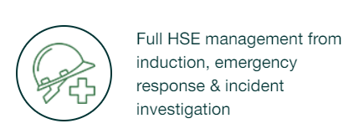
Operations & Maintenance
Client Benefits

Slide 3
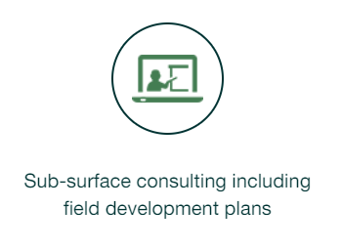
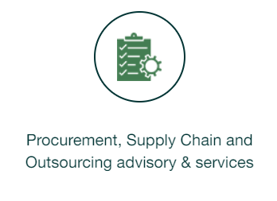
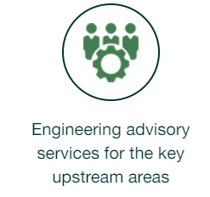
Technical Solutions
Sub-surface modelling & Well Engineering

Slide 4
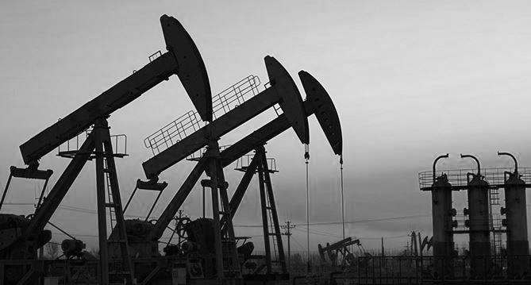
Client Benefits

Slide 5
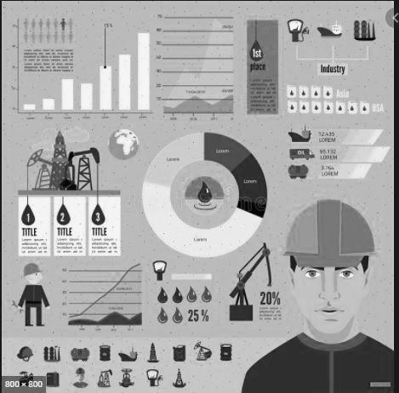
Training Services

Slide 6
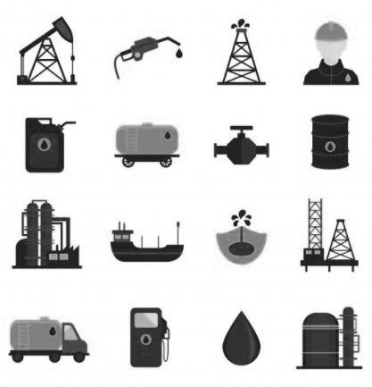
Client Benefits

Slide 7
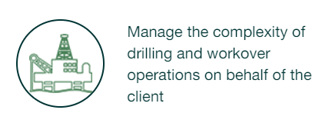
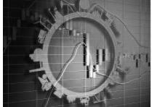
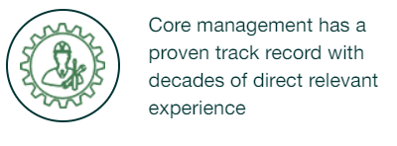
IPD Services

Slide 8
Client Benefits

Slide 9
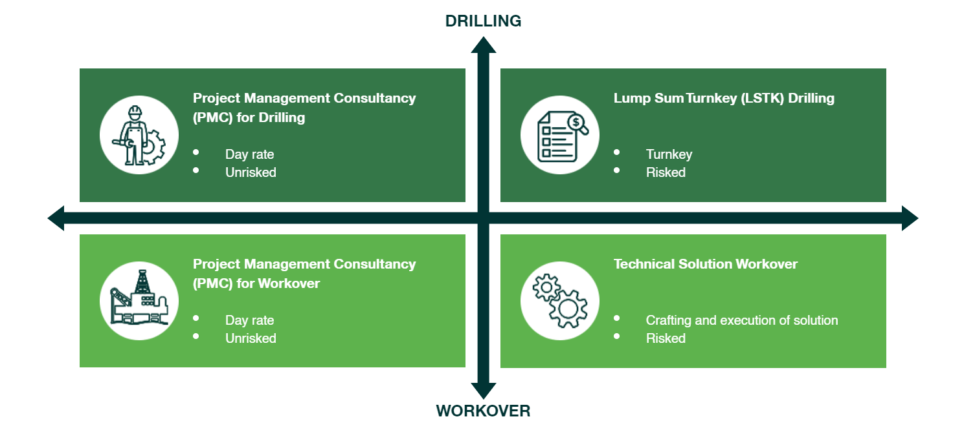
Commercial Models

Slide 10
People
Processes

Slide 11
Oil Industry Public Seminars & Virtual, Instructor-Led Training
DA also offers two-day public seminars and virtual, instructor-led courses. Each two-day seminar focuses on discussions, activities, and real-world examples to provide all participants with the knowledge they need to perform their tasks safely and efficiently. DA’s virtual, instructor-led option provides your employees with the opportunity to connect to a live classroom seminar remotely via web link with an on-site experience and the convenience of remote access
DA's Workforce Management Consultants can help develop customized:
Program Audits Incumbent Gap Analysis (Knowledge and/or Skills)
Job Task Analysis Documentation Services
On-Site Classroom Instruction Operations, Maintenance, Safety, and Administrative Procedure Development
Oil and Gas Performance and Compliance Management Solutions
Our EHS Workforce Management Solutions are designed to help you manage your oil and gas facility operations and EHS challenges. Our software systems are designed to either perform individually or together as a complete system – freeing up valuable resources needed for analysis, tracking, and compliance while streamlining your recordkeeping.
Remain compliant with industry standards and regulations Simplify your worker safety management
Streamline incident reports Easily track skills and safety training and verifications

Slide 12
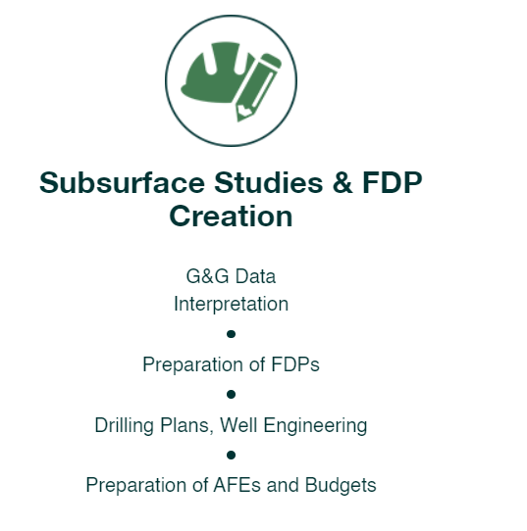
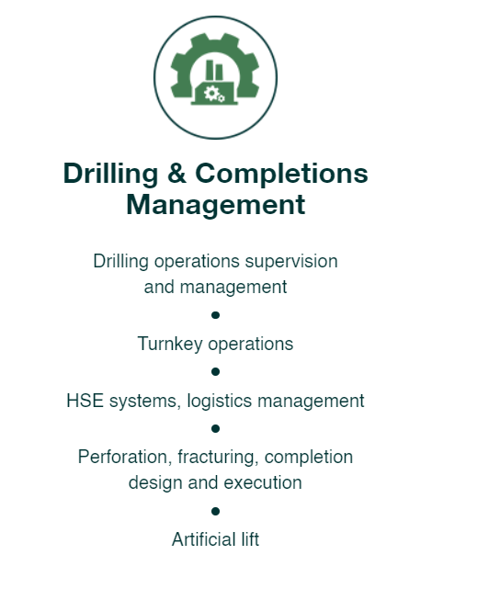
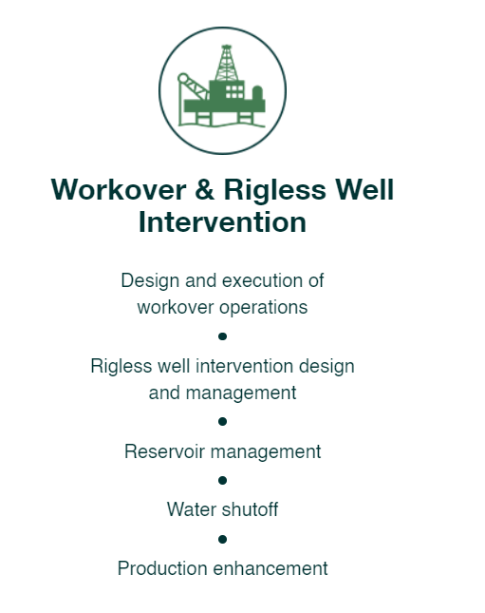
End-to-End Solutions

